Slide 1
05
Setting Up Your Development Environment (Windows)
Python Programming for Linguists
Ingo Kleiber, 2020

Slide 2
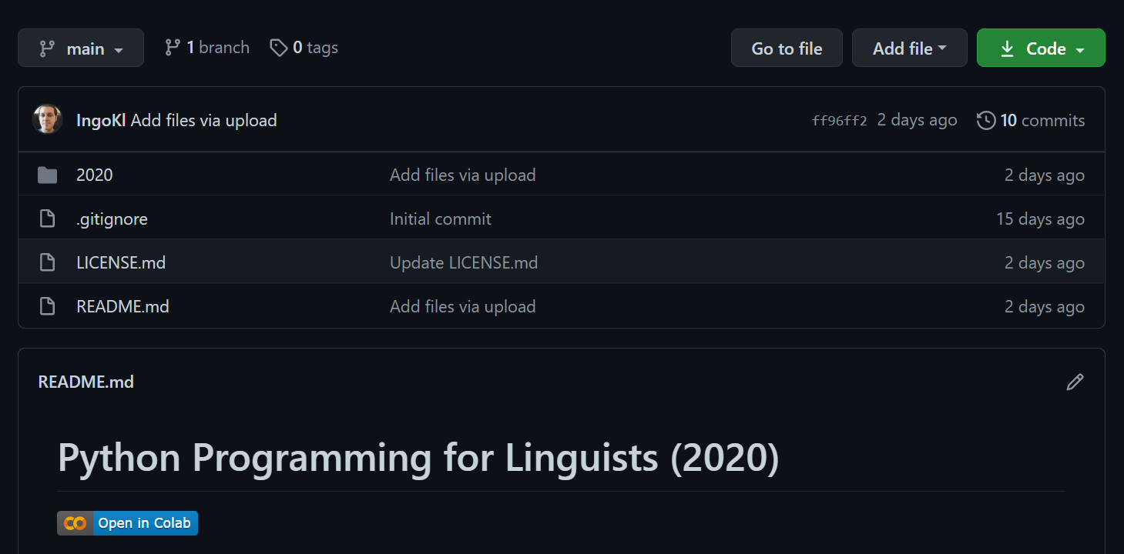

Slide 3

Development Environment
Windows 10
Git for Windows (2.30.0)
Anaconda 3 (2020.11) Individual Edition – Python 3.8
Microsoft Visual Studio Code
https://www.anaconda.com/products/individual

